Slide 1
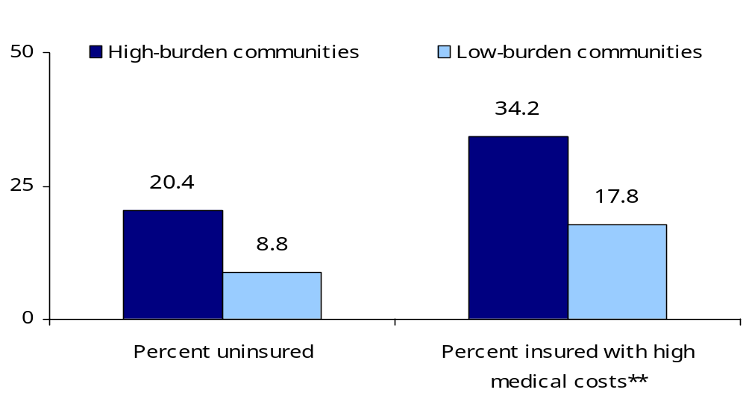
Figure 1. Communities that have the highest medical cost burdens have high uninsured rates as well as large numbers of insured residents with high medical costs.
*
*
* Difference with high-burden communities is statistically significant at the .05 confidence level.
** Underinsured is defined as having some type of insurance but still incurring out-of-pocket expenditures
exceeding 5% of family income for individuals with incomes below 200% of the federal poverty level and
greater than 10% of family income for those at or above 200% of poverty.
Source: 2003 Community Tracking Study Household Survey.

Slide 2
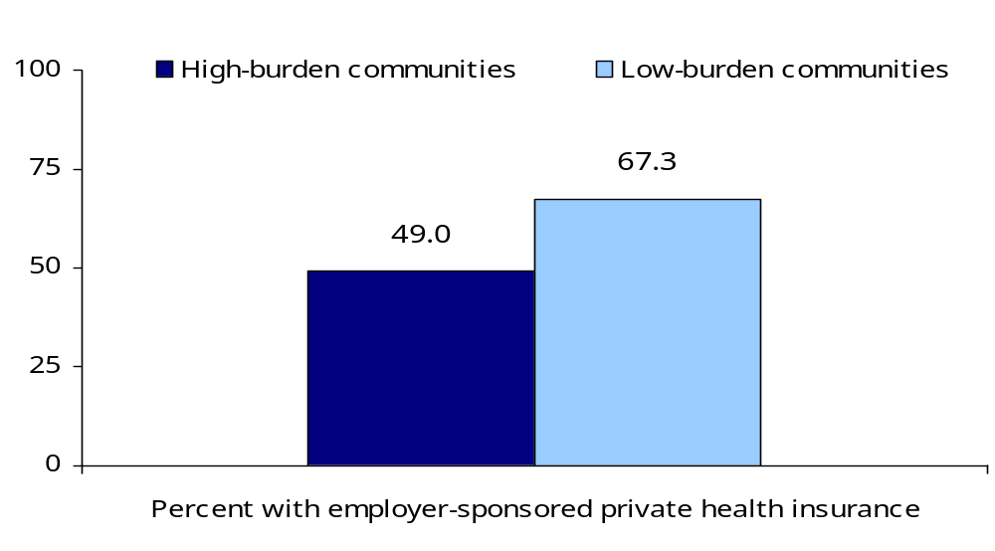
Figure 2. Rates of employer-sponsored insurance coverage are considerably lower in communities where medical cost burdens are high.
*
* Difference with high-burden communities is statistically significant at the .05 confidence level.
Source: 2003 Community Tracking Study Household Survey.

Slide 3
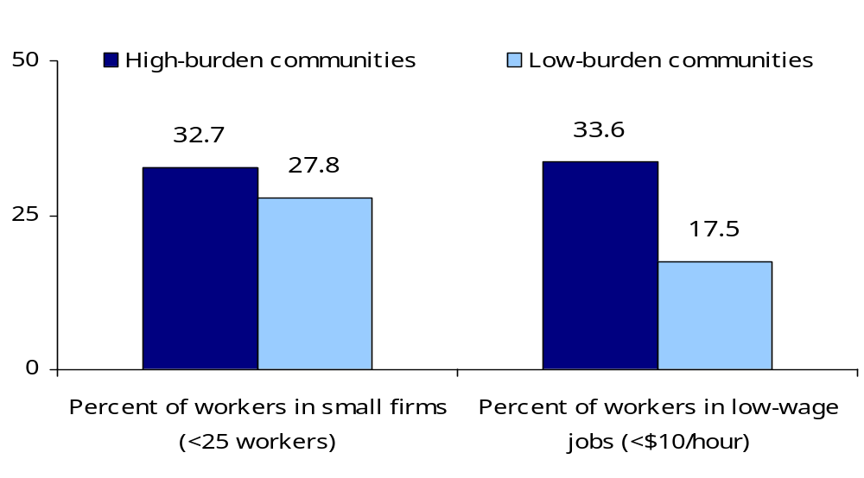
Figure 3. Compared with workers in communities where medical cost burdens are low, workers in high-burden communities are twice as likely to have low-wage jobs.
*
*
* Difference with high-burden communities is statistically significant at the .05 confidence level.
Source: 2003 Community Tracking Study Household Survey.

Slide 4
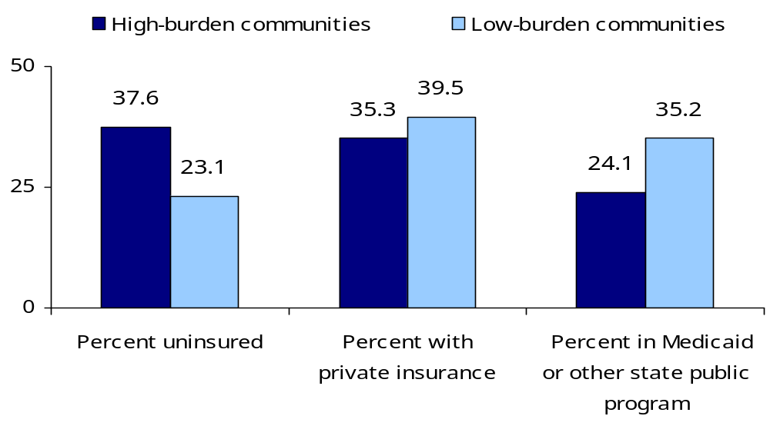
Figure 4. High uninsured rates in communities with high medical cost burdens often reflect lower levels of public coverage for low-income people.
Coverage among nonelderly low-income people (<200% of poverty level)
*
*
* Difference with high-burden communities is statistically significant at the .05 confidence level.
Source: 2003 Community Tracking Study Household Survey.

Slide 5
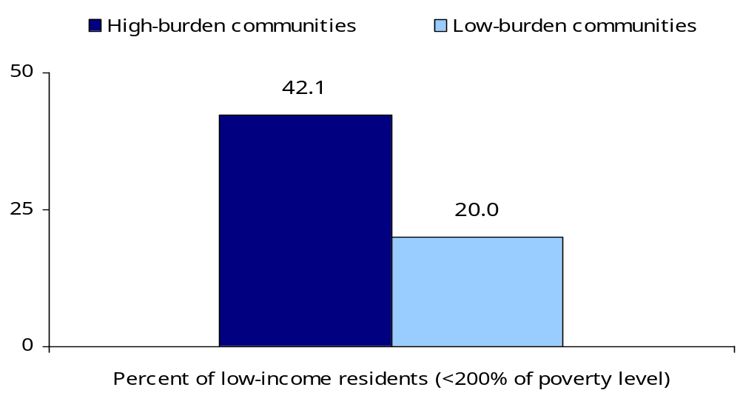
Figure 5. In communities where medical cost burdens are high, the proportion of residents who are low-income is more than twice that of low-burden communities.
*
* Difference with high-burden communities is statistically significant at the .05 confidence level.
Source: 2003 Community Tracking Study Household Survey.

Slide 6
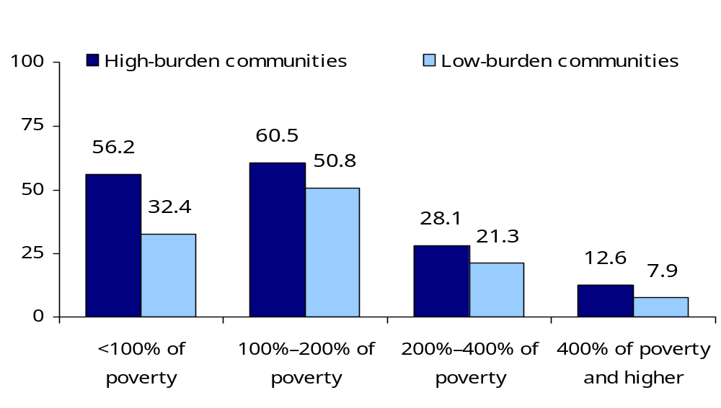
Figure 6. In communities where cost burdens are high, insured people, regardless of income, are more likely to have high out-of-pocket and premium costs.
Percent insured with high costs relative to income
*
*
*
* Difference with high-burden communities is statistically significant at the .05 confidence level.
Source: 2003 Community Tracking Study Household Survey.

Slide 7
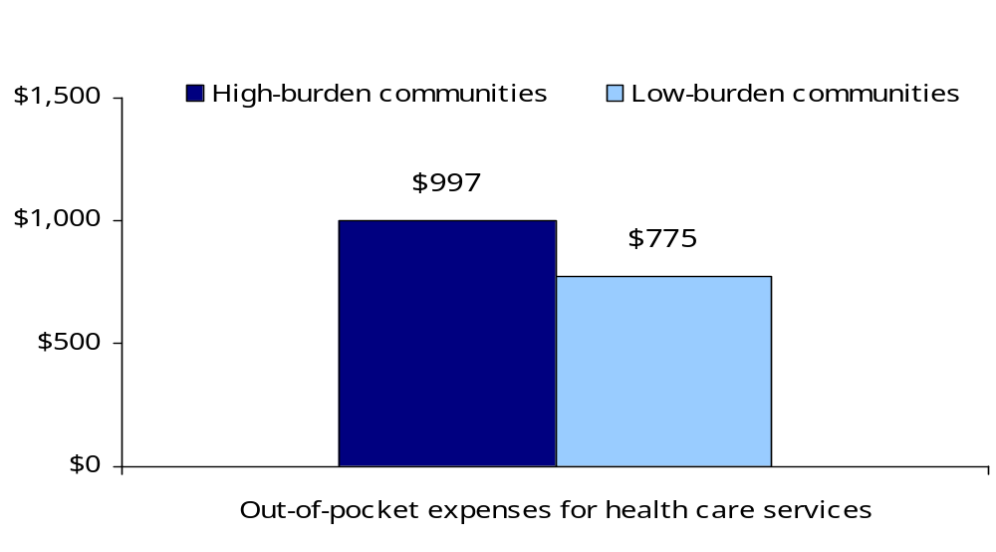
Figure 7. Among the privately insured, out-of-pocket health spending is about one-quarter higher in communities where medical cost burdens are high.
Average annual out-of-pocket expenses
for services among privately insured
*
* Difference with high-burden communities is statistically significant at the .05 confidence level.
Source: 2003 Community Tracking Study Household Survey.

